Slide 1
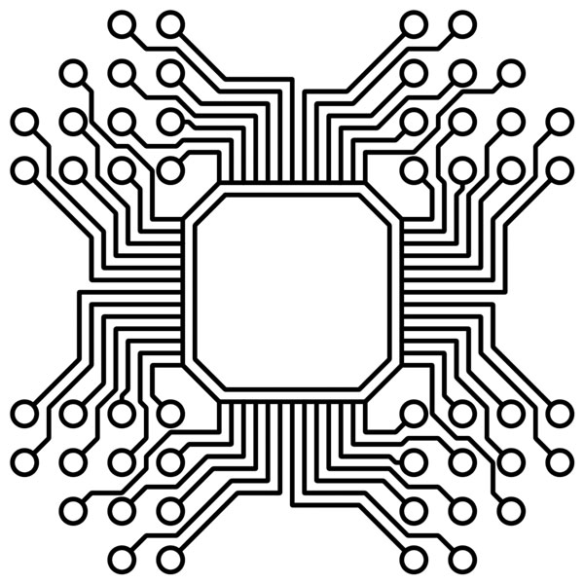
Advanced embedded Programming
Lecturer: Dr. Bui Ha Duc
Dept. of Mechatronics
Email: ducbh@hcmute.edu.vn

Slide 2
C Library
Library: bunch of files that contain just functions and declaration → Write once use many
C Library is a collection of object files
Types of C library:
Static libraries: linked into the program during the linking phase of compilation and are not relevant during runtime
Dynamic libraries: linked by multiple program at the same time during running time

Slide 3
Create a C library
Create static libraries
Step 1: create C source files containing any functions that will be used.
Step 2: Compile these files into objects
gcc -c libraryCode.c -o object.o
Step 3: Create library
ar rc libname.a object.o
Step 4: Linking your program to the libraries, make sure you specify where the library can be found
gcc file.c -L. -lname -o newfile

Slide 4
Create a C library
Create dynamic libraries
Step 1: create C source files containing any functions that will be used.
Step 2: Compile these files into Position Independent Code
gcc -fPIC libraryCode.c -o object.o
Step 3: Create library
gcc -shared -o libname.so objfile.o
Step 4: Linking your program to the libraries, make sure you specify where the library can be found
gcc file.c -L. -lname -o newfile

Slide 5
Create a C library
Create dynamic libraries
Step 5: Copy file library.h to /usr/include and
file library.so to /usr/lib
or declare library path in List of Dynamic Dependencies
export LD_LIBRARY_PATH=:/path/to/library.so

Slide 6
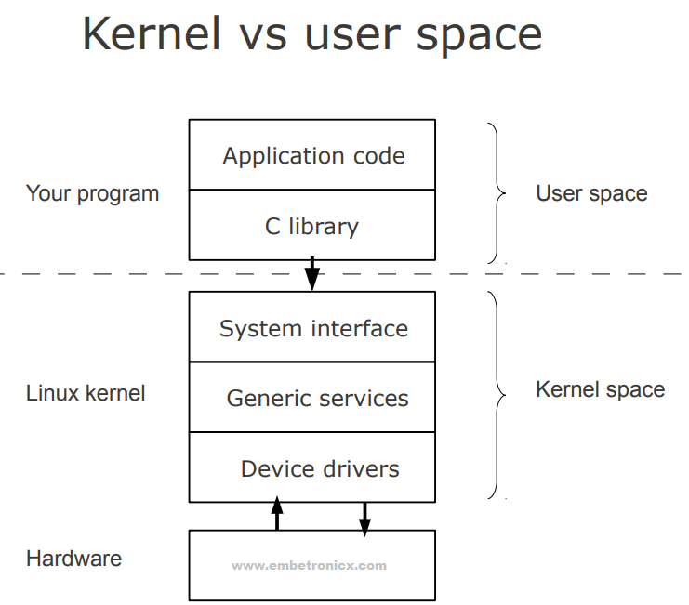
Device Driver
Device driver is a computer program that operates or controls a particular type of device that is attached to a computer
Driver provides a software interface to hardware devices, enabling operating systems and other computer programs to access hardware functions.

Slide 7
Functions of Driver
Isolate the user program from the complexity of the hardware device
E.g. open, copy a file in hard disk
Provides a consistent user interface to a large variety of hardware device

Slide 8
Device Driver Architecture
Linux lets you add and remove kernel components at runtime
Provide flexibility
Enhance upgrade capability
Module can be stored on media other than root
Linux device driver are broadly classified into 3 basic categories:
Character devices can be thought of as serial streams of sequential data.
e.g. serial ports and keyboards.
Block devices are characterized by the capability to read and write blocks of data to and from random locations on an addressable medium
e.g. hard drives and USB Flash drives.
Network devices This is similar to a block device but is used for transmitting and receiving network packets rather than disk blocks

Slide 9
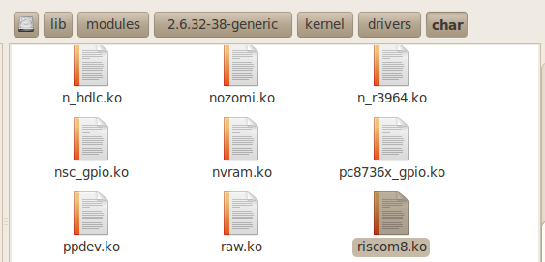
Driver location
Generally, a driver is stored in folder /lib/modules/<kernel_version>/kernel
Driver is stored as *.ko file
List the character and block device drivers that are currently loaded and active by reading /proc/devices
cat /proc/devices

Slide 10
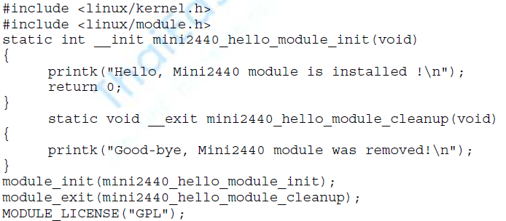
Minimal Device Driver
Notes:
No main() function
No built-in C function
2 fundamental function
module_init()
module_exit()
printk : print messeage to kernel log files
Notes:
When the module is loaded, the module-initialization function is called. We specify the initialization function that will be executed on module insertion using the module_init() macro. We declare it as follows: module_init(hello_init);
when we unload the module (using the modprobe -r command), our module exit routine is called. As shown in Listing 8-1, the exit routine is specified using the module_exit() macro. In a real driver, this is where you undo everything that was done on entry, such as freeing any memory or returning the device to a known, harmless state.

Slide 11
Compile a Driver
A device driver must be compiled against the kernel on which it will execute
Method 1: Create a Make file and put it in the same folder with file hello.c
Run the Make file
Load the module
obj-m := hello1.o KDIR := /lib/modules/$(shell uname -r)/build PWD := $(shell pwd) default: $(MAKE) -C $(KDIR) M=$(PWD) modules
Notes:
Sau khi đã có mã nguồn C của driver đơn giản như trên, cần tiến hành biên dịch để tạo ra file module (có đuôi mở rộng .ko, trong trường hợp này là file ofd.ko). Chúng ta sử dụng cách thức biên dịch ở tầng nhân để làm điều này. Cụ thể cần viết một Makefile trong đó thực hiện việc đăng ký thư viện biên dịch ở tầng nhân (kernel build system) từ mã nguồn nhân, và đăng ký driver đang cần biên dịch.

Slide 12
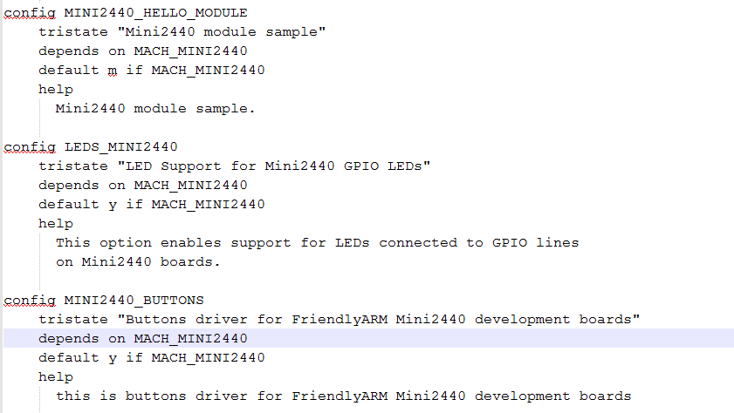
Compile a Driver
Method 2: Add code to the kernel source tree, and do the appropriate configuration
Step 1. Edit the configuration file Kconfig (linux-2.6.32.2/drivers/char/Kconfig)
Notes:
add options to make it appear in the make menuconfig
select the <M> this means that the option should compiled as a module; then press the space will become <*>, which means should this option compiled into the kernel, we choose <M>

Slide 13
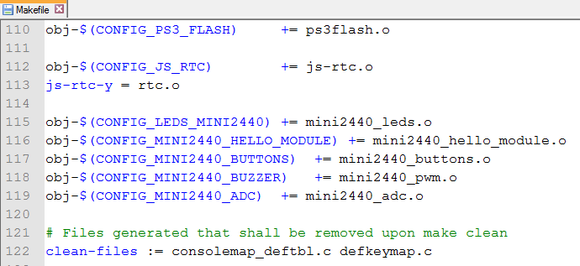
Compile a Driver
Step 2. edit the Makefile in the kernel configuration (linux-2.6.32.2/drivers/char/Makefile)

Slide 14
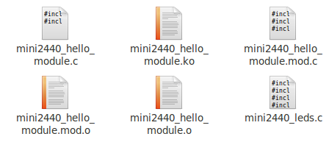
Compile a Driver
Step 3. back to linux-2.6.32.2 root directory, run the makefile
make modules
Then copy the .ko file to /lib/modules/2.6.32.4-FriendlyARM folder on the FriendlyARM board

Slide 15
Loading a driver
modprobe : a utility used to insert a driver into a running kernel.
modprobe mini2440_hello_module
Similar to insmod
modprobe –r : remove a driver
Similar to rmmod
rmmod mini2440_hello_module
lsmod : list of driver which is inserted in to the kernel

Slide 16
Practical Device Driver
Beside module_init and module_exit, we need other functions to interface the device with the program
open() : prepare the driver for subsequent operations after the device driver is loaded into a live kernel
release() : provided to clean up after operations are complete
ioctl() : a special system call for nonstandard communication with the driver

Slide 17
Device Nodes and mknod
A device node is a special file type in Linux that represents a device
Linux keep device nodes in a directory called /dev.
This node is mapped to a device driver using the major and minor numbers
major number (12-bit) maps the device node to a device driver
minor number (20-bit) tells the driver which interface is being accessed
A dedicated utility is used to create a device node on a file system is called mknod.
mknod /dev/hello1 c 234 0
c means that a char device is to be created
234 major number registered with the kernel
0 minor number, not registered with the kernel
Notes:
After executing this command on our target embedded system, we end up with a new file called /dev/hello1 that represents our device driver module.

Slide 18
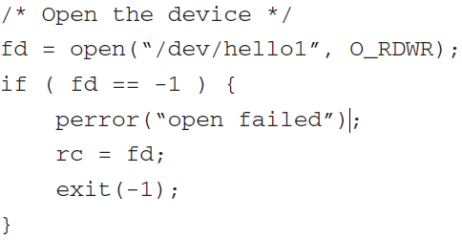
How to use device driver
Call open() function
Call desired command

Slide 19
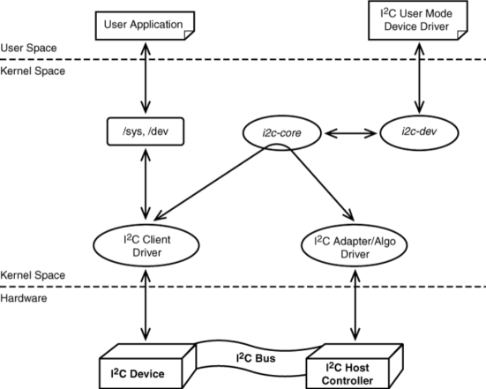
Linux Client driver
A client driver is a type of driver that interacts with a specific hardware device.

Slide 20
Build a client driver on Raspberry
1. Install Linux kernel headers:
sudo apt update
sudo apt install raspberrypi-kernel-headers
2.

